Slide 1
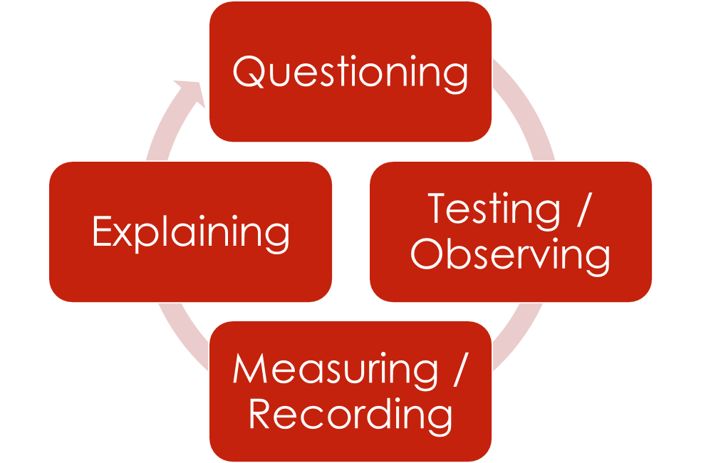
Daily Review
This cycle is called the scientific method.
Think, Pair, Share: Describe what each component involves.
How are we questioning? How are we testing/ observing?
How are we measuring/ recording? How do we explain?

Slide 2
Safety in Science Year 7 Science

Slide 3
Learning Objectives
CFU
What are we going to learn?
Identify potential hazards in the science classroom
Write simple safety rules
Activate Prior Knowledge
There are many situations where rules are put in place to keep you safe, for example road rules or height restrictions at theme parks.
Think, Pair, Share: Name a rule in your everyday life that is there to keep you safe.
Vocabulary
Hazard: Danger or risk

Slide 4
Concept Development
CFU
Which of the following are hazards in the science classroom? Burns from hot objects Cuts from glass Electric shock Slipping on spilt water
Scientists may be exposed to a variety of hazards.
If something can possibly cause harm to yourself or others, then don’t do it.
Look at the picture on the next slide.
On your white board, write down all the unsafe things you can see.
Vocabulary
Hazard: Danger or risk

Slide 5
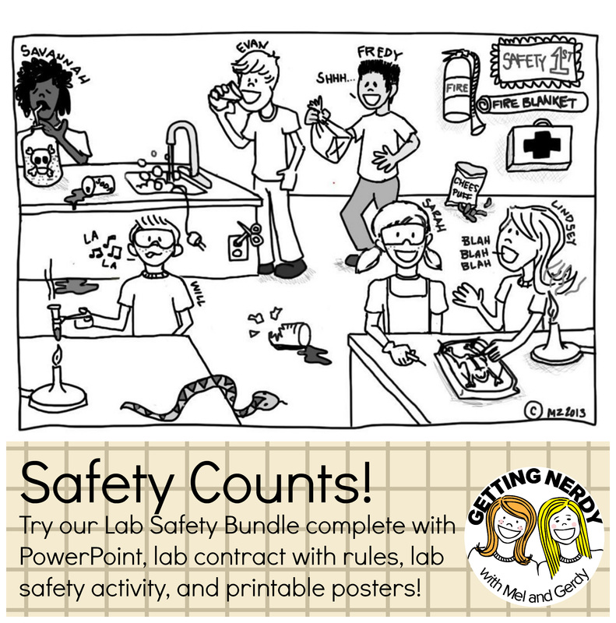

Slide 6
Skill Development/Guided Practice
CFU 1
What is the hazard in this part of the picture?
Scientists may be exposed to a variety of hazards.
If something can possibly cause harm to yourself or others, then don’t do it.
CFU 2
How could this hazard cause harm?
We will now write some rules to protect us from the hazards you have found in the picture using the following steps.
Step 1: Identify the hazard
Lindsey’s long hair is close to the Bunsen burner flame
Step 2: Work out how the hazard could cause harm
Her hair could catch on fire
Step 3: Write a rule that will protect you from the hazard (make it positive if possible)
Always tie up long hair in the Science classroom
Vocabulary
Hazard: Danger or risk

Slide 7
Skill Development/Guided Practice
CFU 1
What is the hazard in this part of the picture?
Scientists may be exposed to a variety of hazards.
If something can possibly cause harm to yourself or others, then don’t do it.
CFU 2
How could this hazard cause harm?
We will now write some rules to protect us from the hazards you have found in the picture using the following steps.
Step 1: Identify the hazard
Electrical equipment in the sink/near water
Step 2: Work out how the hazard could cause harm
Increased risk of electric shock
Step 3: Write a rule that will protect you from the hazard (make it positive if possible)
Keep electrical equipment away from water
Vocabulary
Hazard: Danger or risk

Slide 8
Skill Development/Guided Practice
Scientists may be exposed to a variety of hazards.
If something can possibly cause harm to yourself or others, then don’t do it.
We will now write some rules to protect us from the hazards you have found in the picture using the following steps.
Step 1: Identify the hazard
Step 2: Work out how the hazard could cause harm
Step 3: Write a rule that will protect you from the hazard (make it positive if possible)
Vocabulary
Hazard: Danger or risk

Slide 9
Skill Development/Guided Practice
Scientists may be exposed to a variety of hazards.
If something can possibly cause harm to yourself or others, then don’t do it.
We will now write some rules to protect us from the hazards you have found in the picture using the following steps.
Step 1: Identify the hazard
Step 2: Work out how the hazard could cause harm
Step 3: Write a rule that will protect you from the hazard (make it positive if possible)
Vocabulary
Hazard: Danger or risk

Slide 10
Relevance
Scientists may be exposed to a variety of hazards.
If something can possibly cause harm to yourself or others, then don’t do it.
Safety is everyone’s responsibility in the Science classroom.
Being able to identify hazards and the potential harm they can cause will help you to work more safely in the Science classroom.

Slide 11
Skill Closure
Identify the hazard shown in this part of the original picture.
Skill Closure
Explain how this hazard could cause harm to Evan.
Skill Closure
Write a rule that could protect Evan from the hazard.

Slide 12
Independent Practice
For each situation below, follow the steps to write a safety rule to protect you from the hazard.
Step 1: Identify the hazard
Step 2: Work out how the hazard could cause harm
Step 3: Write a rule that will protect you from the hazard (make it positive if possible)
Situation 1: Carly leaned across the Bunsen burner to pass a beaker to her partner.
Situation 2: At the end of an experiment involving chemicals, George left for break without washing his hands.

